Slide 1
SQL PROJECT
By- Ishant Pathania

Slide 2
MOVIE DATABASE
This is a sample database designed for the movie industry.
It focuses on managing and retrieving data related to movies, aiming to answer common questions that movie enthusiasts might have.
The database structure facilitates queries about actors, genres, directors, movies, reviews, ratings, and more.

Slide 3
Key Highlights:
Purpose: To satisfy the curiosities of movie lovers by providing accessible and organized movie-related information.
Database Tables:
Actor
Genres
Director
Movie
Movie_Cast
Movie_Direction
Movie_Genres
Rating
Reviewer

Slide 4
Example Queries:
Find movie titles and release years.
Identify movies released in specific years or before a given year.
Retrieve reviewers and movie titles in a single list.
List movies with no ratings or find movies based on specific IDs or keywords.
Search for actors based on names and roles in movies.
The project uses SQL for data retrieval, showcasing practical and diverse queries. It effectively demonstrates database capabilities for a movie-related industry.

Slide 5
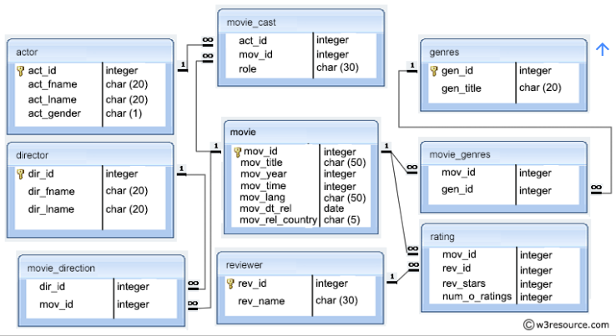
SCHEMAS

Slide 6
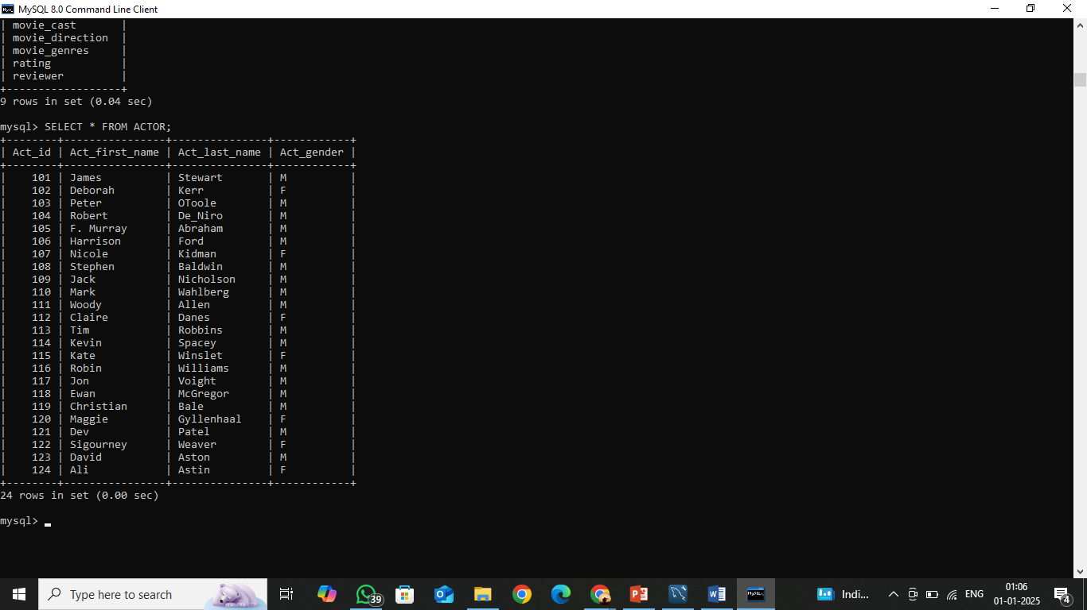
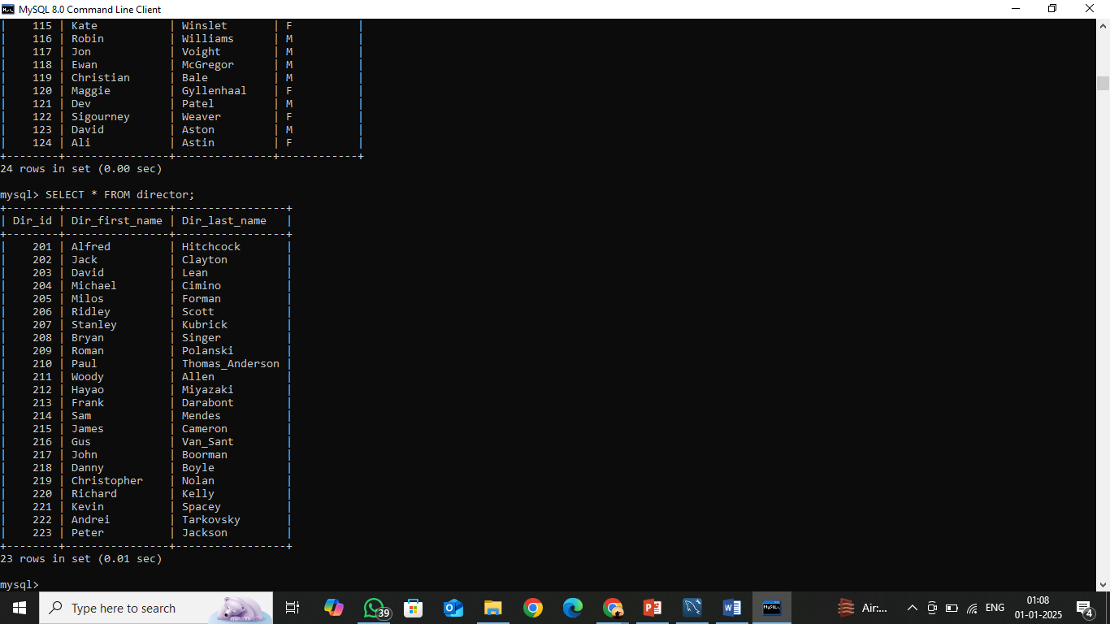
TABLE OF MOVIE PROJECT :-
ACTOR :-
DIRECTOR :-

Slide 7
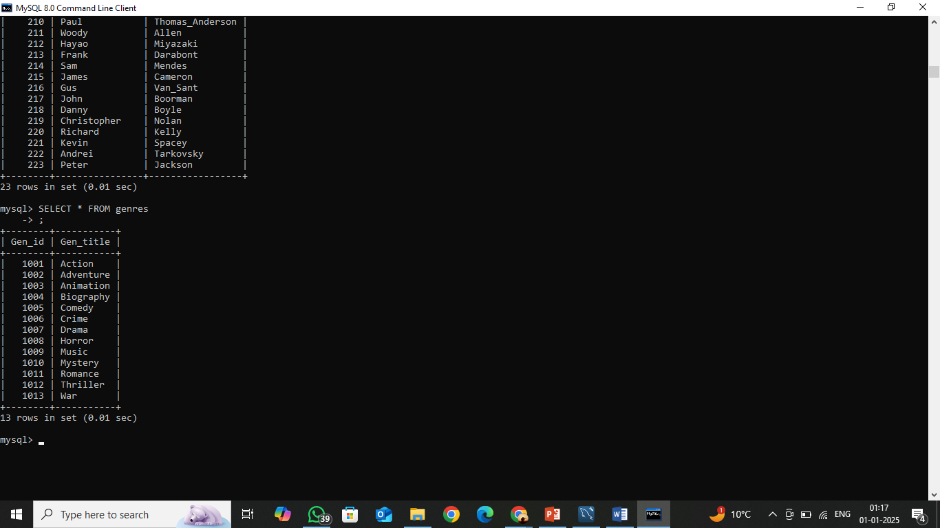
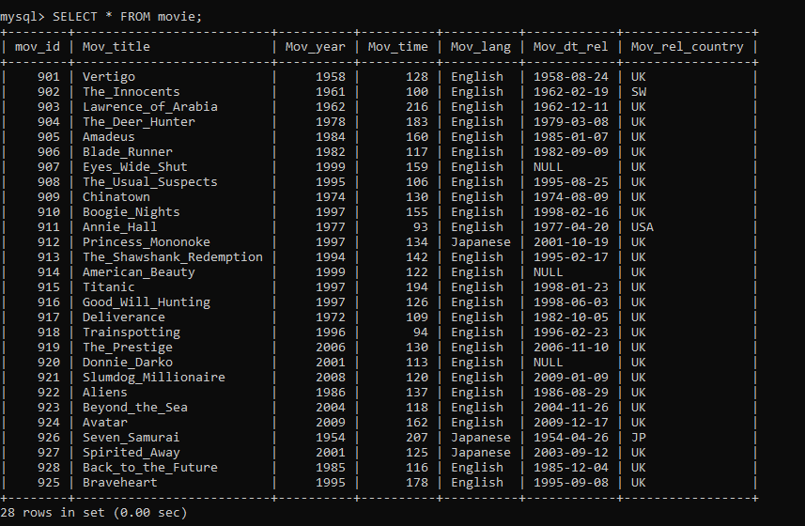
GENRES :-
MOVIE :-

Slide 8
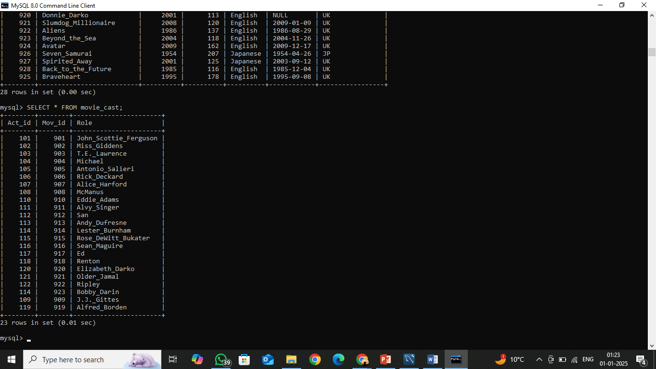

MOVIE_CAST :-
MOVIE_DIRECTION :-

Slide 9

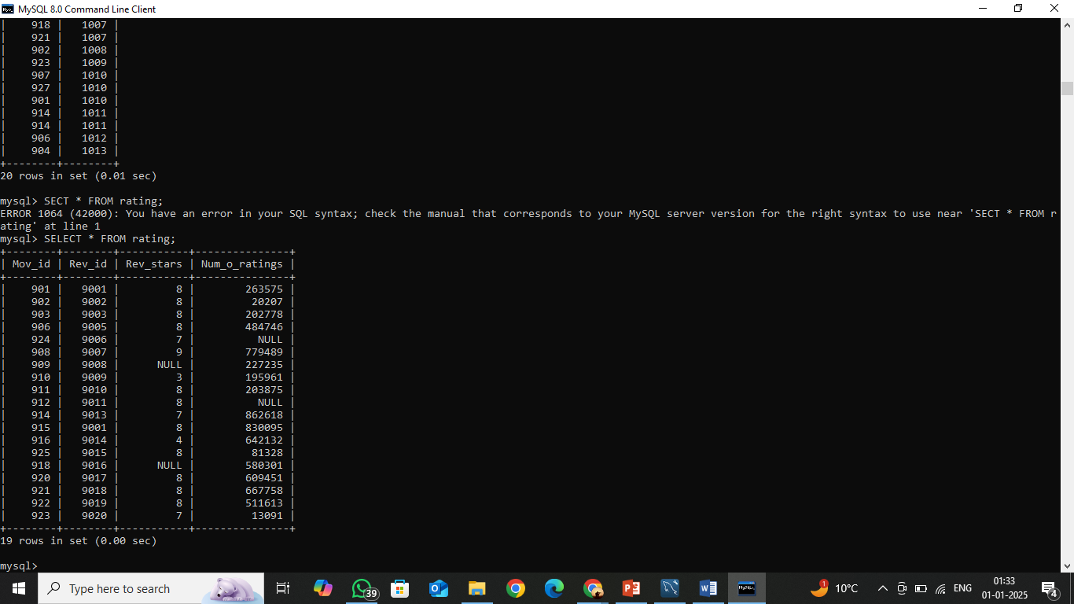
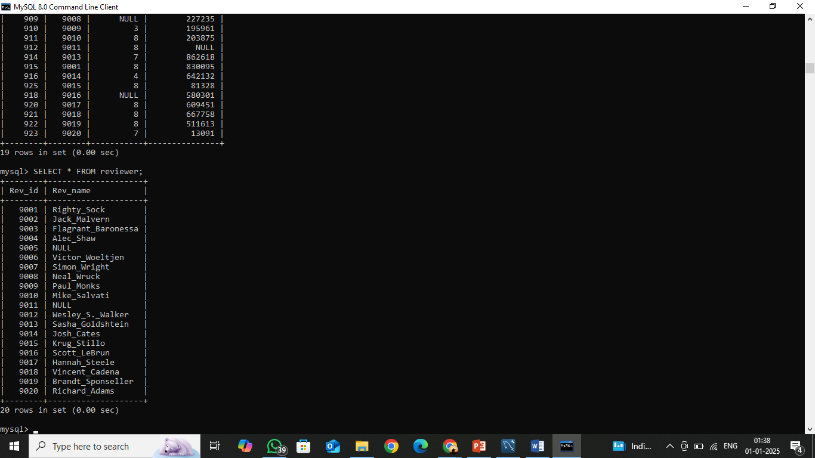
MOVIE_GENRES :-
RATING :-
REVIEWER :-

Slide 10
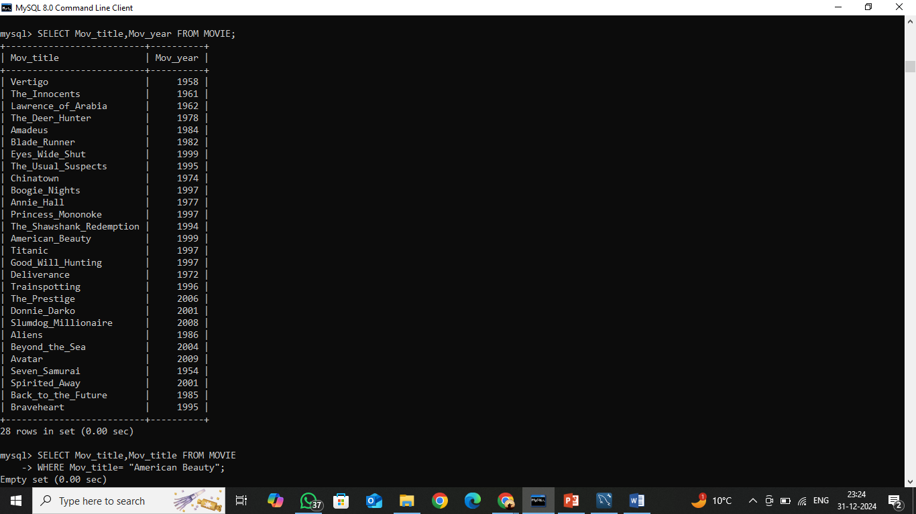
Q1. Find the name and year of the movies. Return movie title, and movie release year.
ANS. SELECT Mov_title , Mov_year FROM movie:

Slide 11

Q2. Find when the movie 'American Beauty' released. Return movie release year.
ANS. SELECT Mov_title,Mov_year FROM movie
WHERE Mov_title= "American_Beauty";

Slide 12
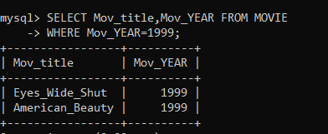
Q3. Find the movie that was released in 1999. Return movie title.
Ans. SELECT Mov_title,Mov_year FROM movie
WHERE Mov_year=1999 ;

Slide 13

Q4. Find those movies, which were released before 1998. Return movie title.
ANS. SELECT Mov_title,Mov_YEAR FROM movie
WHERE Mov_YEAR<1998;

Slide 14
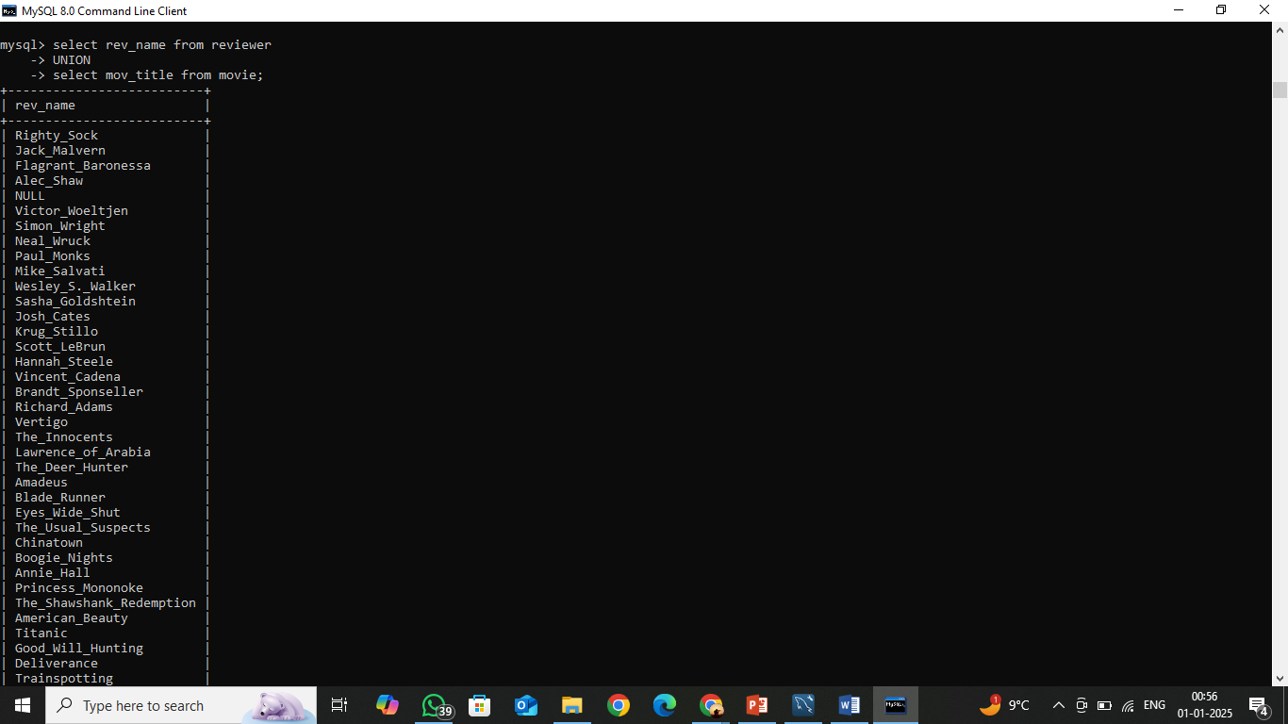
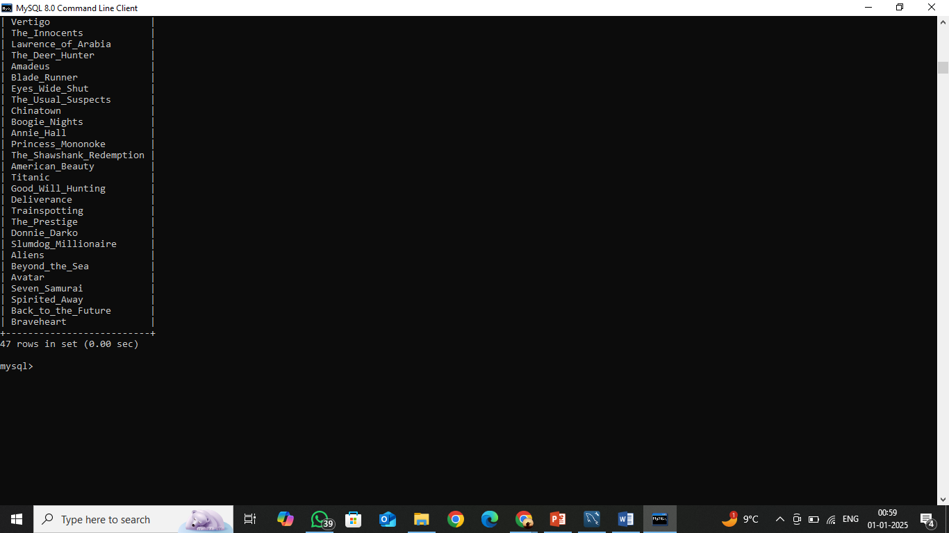
Q5. Find the name of all reviewers and movies together in a single list.
ANS. SELECT rev_name FROM reviewer
UNION
SELECT mov_title FROM movie;

Slide 15

Q6. From the following table, write a SQL query to find all reviewers who have rated seven or more stars to their rating. Return reviewer name.
ANS. SELECT reviewer.rev_id,reviewer.rev_name,rating.rev_start FROM
REVIEWER INNER JOIN RATING ON
REVIEWER.REV_ID=RATING.REV_ID;

Slide 16

Q7. From the following tables, write a SQL query to find the movies without any rating. Return movie title.
ANS. SELECT rating.mov_id,movie.mov_title FROM Rating INNER JOIN
movie ON rating.mov_ID=movie.mov_ID;

Slide 17
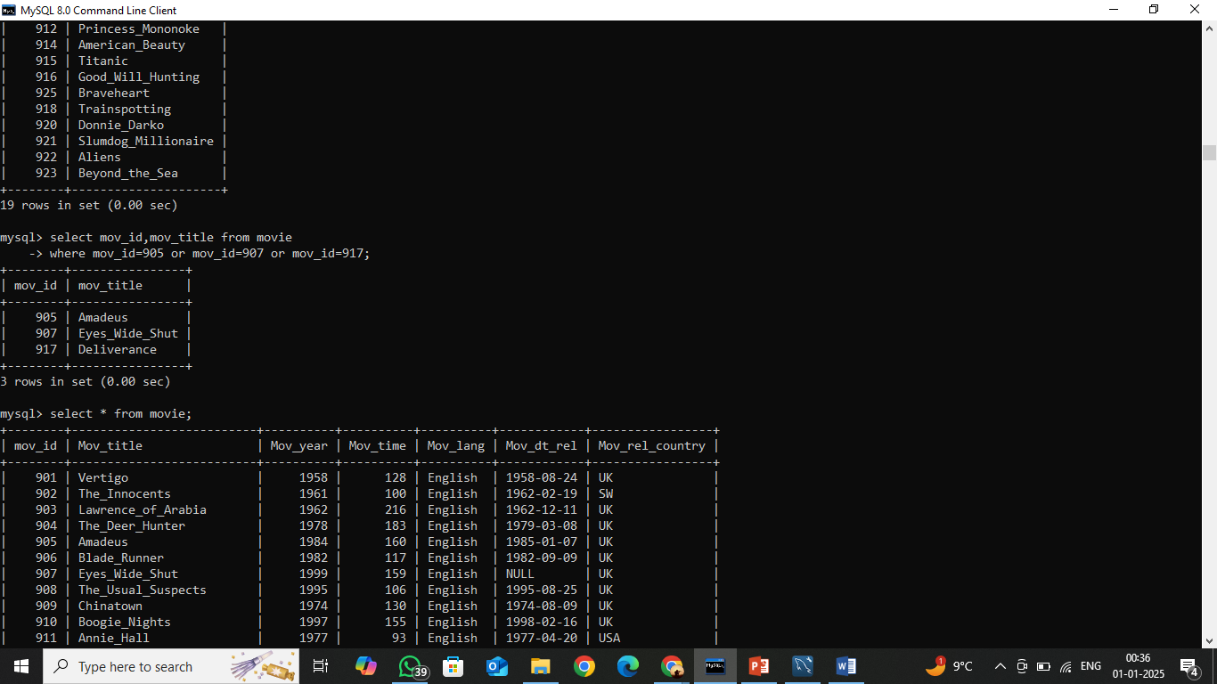
Q8. Find the movies with ID 905 or 907 or 917. Return movie title.
ANS. Select mov_id,mov_title FROM movie
WHERE mov_id=905 or mov_id=907 or mov_id=917;

Slide 18

Q9. Find the movie titles that contain the word 'Boogie Nights'. Sort the result-set in ascending order by movie year. Return movie ID, movie title and movie release year.
ANS. Select mov_id,mov_title,mov_year FROM movie
WHERE mov_title LIKE "Boogie_Nights%"
ORDER BY MOV_YEAR ASC;

Slide 19
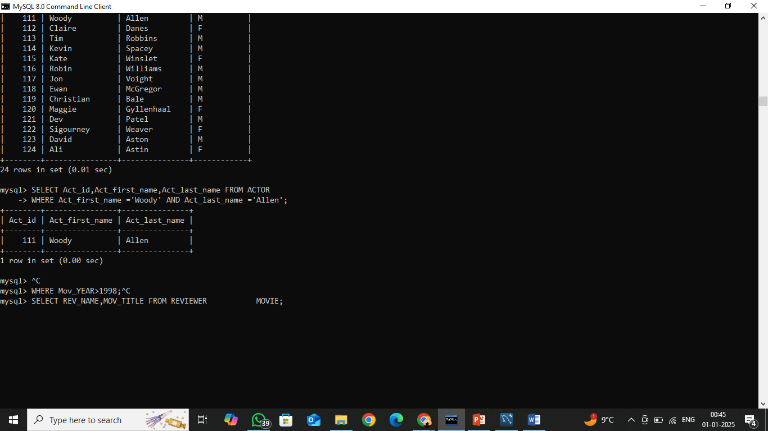
Q10. Find those actors with the first name 'Woody' and the last name 'Allen'. Return actor ID.
ANS. SELECT Act_id,Act_first_name,Act_last_name FROM actor
WHERE Act_first_name ='Woody' AND Act_last_name ='Allen';

Slide 20
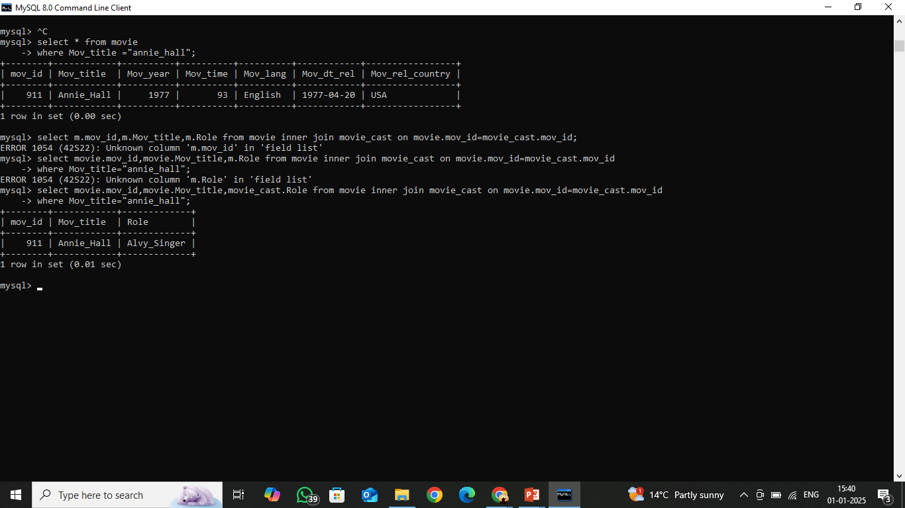
Q11. Find the actors who played a role in the movie 'Annie Hall'. Return all the fields of actor table.
ANS. SELECT movie.mov_id,movie.Mov_title,movie_cast.Role FROM
movie INNER JOIN movie_cast
ON movie.mov_id=movie_cast.mov_id
WHERE Mov_title="annie_hall";

Slide 21
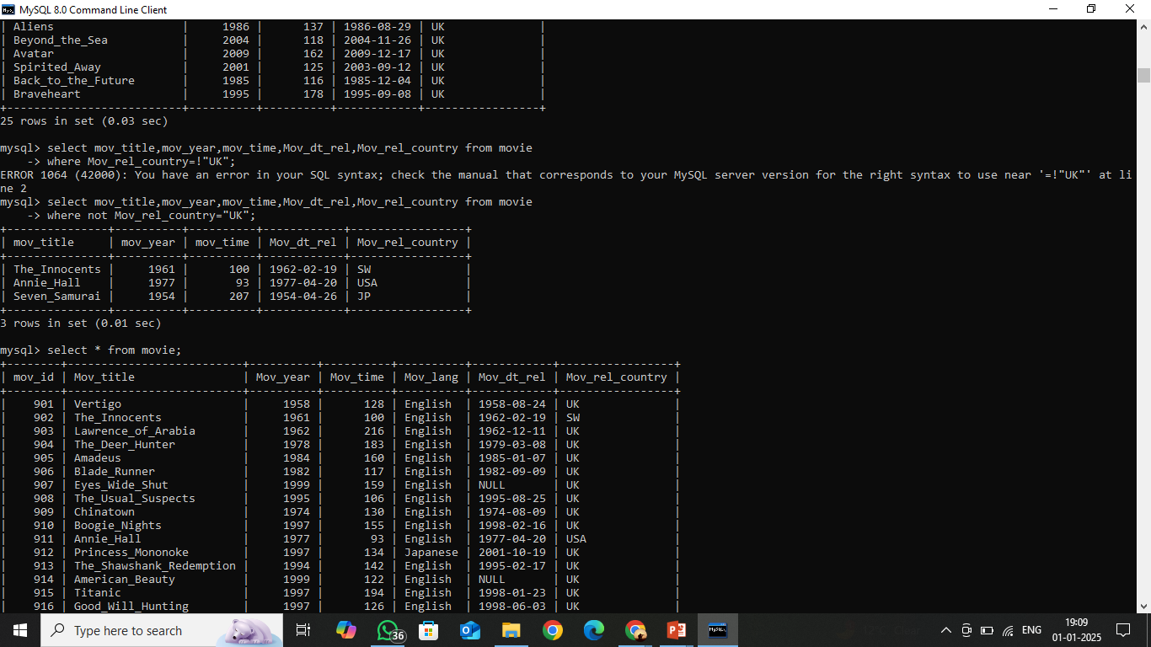
Q12. Find those movies that have been released in countries other than the United Kingdom. Return movie title, movie year, movie time, and date of release, releasing country.
ANS. SELECT mov_title,mov_year,mov_time,Mov_dt_rel,Mov_rel_country
FROM movie
WHERE NOT Mov_rel_country="UK";

Slide 22
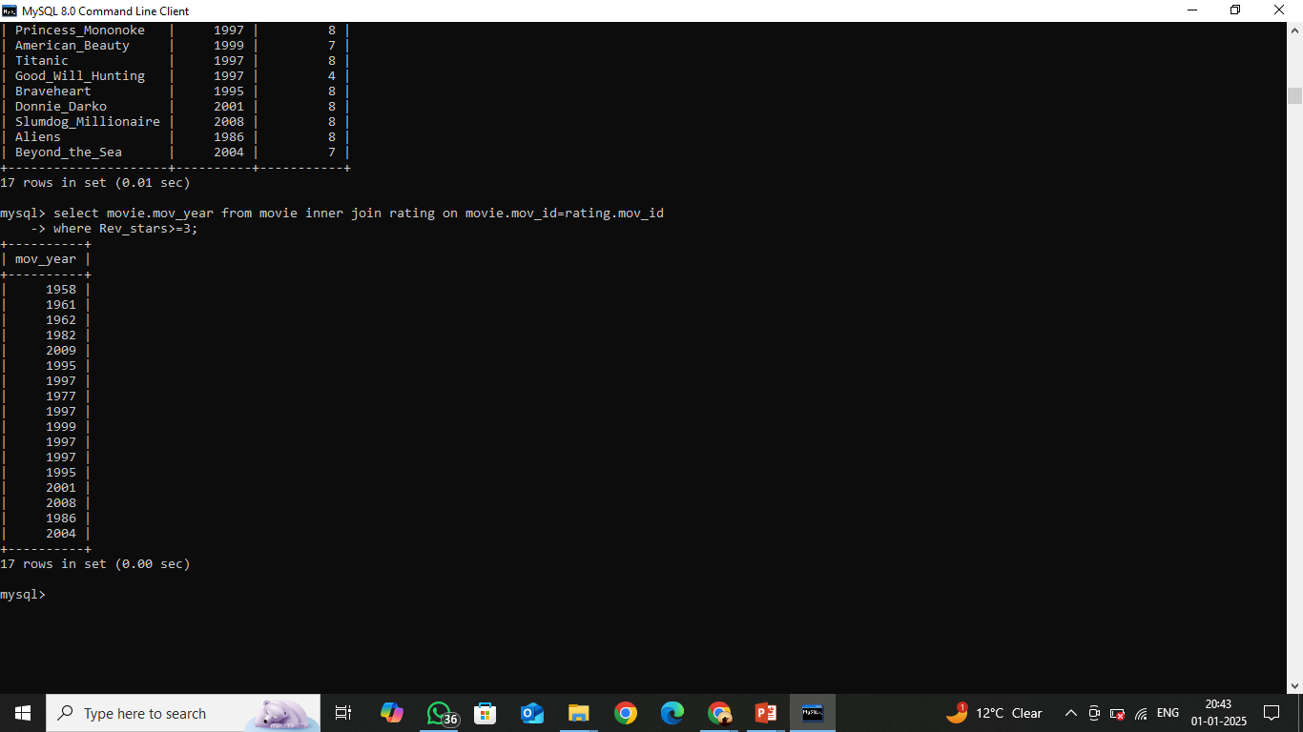
Q13. Find for movies whose reviewer is unknown. Return movie title, year, release date, director first name, last name, actor first name, last name.
ANS. SELECT movie.mov_year FROM movie INNER JOIN rating
ON movie.mov_id=rating.mov_id
WHERE Rev_stars>=3;

